Slide 1
Big Mountain’s Price Optimization
This is your space for legal copy. State whether the information is confidential and how it's intended to be used.
Company Name
Date

Slide 2
Company Name
Date
Big Mountain Resort:
Problem Identification
As it currently stands, we are currently in the process of optimizing our pricing as we feel that it is too low for the features that the resort offers. Comparatively, we are undercharging compared to our competitors but the problem arises in how much we can raise the price to and what improvements can be done to further support this.

Slide 3
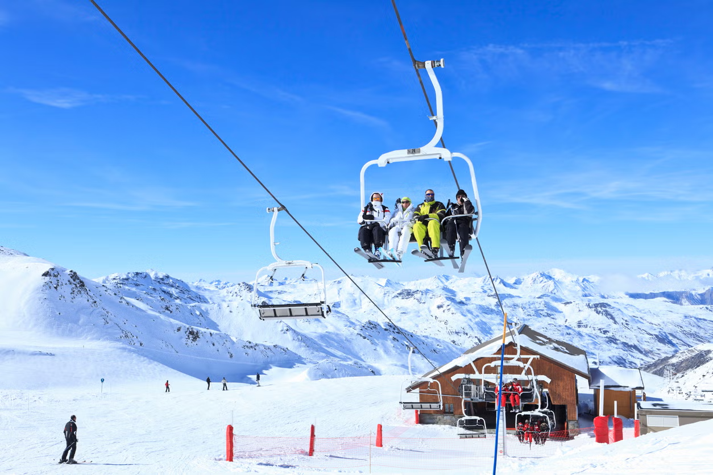
Recommendations
and Key Findings
Company Name
Date
We found that other resorts charge higher with a correlation to skiable areas and their vertical drops. As we are currently undercharging, i suggest we slowly increase the pricing over a period of time as to not scare away any returning customers. We should also invest into a larger skiable area and introducing a new ski lift. We should also introduce better data tracking on things besides the price of the tickets, such as merch sales and other revenue streams that were not available in the data.

Slide 4
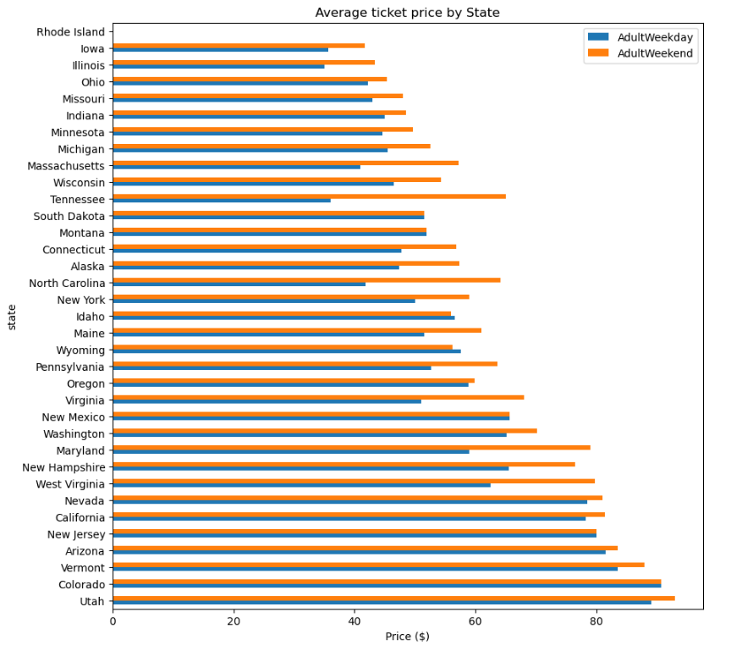

Slide 5
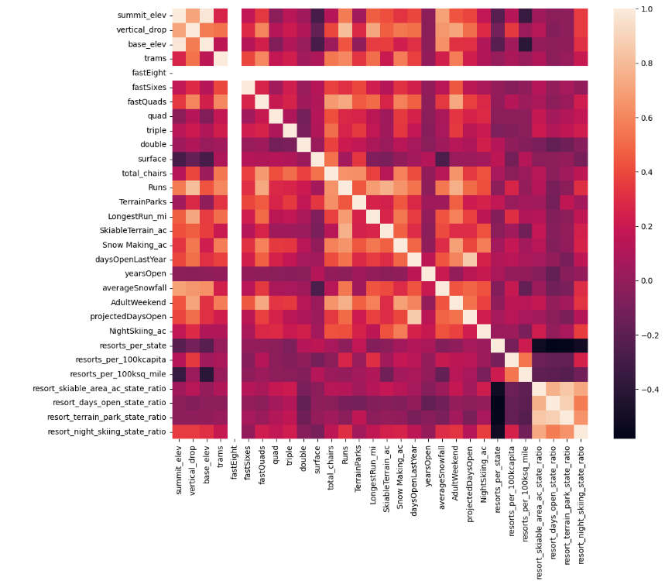

Slide 6
Modeling and Analysis
We first evaluated a simple baseline model using the average price across all resorts, which yielded an R² near 0 (essentially no predictive power).
Next, we trained a linear regression model using features such as skiable acreage, vertical drop, number of lifts, and snowfall. This improved R² substantially and reduced mean absolute error, demonstrating that these attributes meaningfully explain ticket price variance.

Slide 7

Company Name
Date
Summary and Conclusion
Price Optimization:
Current ticket prices appear slightly below the predicted range based on Big Mountain’s attributes.
A modest increase in adult weekend pricing (while maintaining service quality) is supported by the model.
Infrastructure Investments:
Expanding skiable terrain or adding lifts would likely enable further price increases, given the strong positive correlations with ticket price.
Investments in snowmaking and consistent snowfall capture additional value.
Competitive Benchmarking:
Monitor neighboring states’ resorts to ensure pricing remains competitive after any adjustments.
Through systematic data cleaning, exploratory analysis, and predictive modeling, this project identified the key drivers of ski‐resort ticket prices and applied those insights to Big Mountain Resort. The analysis confirms that skiable acreage, vertical drop, and number of lifts are the strongest predictors of price, and that Big Mountain’s current rates sit slightly below the level justified by its attributes. By implementing a modest price increase and strategically investing in infrastructure, the resort can capture additional revenue while remaining competitive. Continued data collection—such as visitor demographics and real-time operational metrics—will further refine these recommendations and help management respond proactively to changing market conditions.

